Slide 1
SYNERGISTIC FORMATION OF OUTPUT PHOTOVOLTAIC CHARACTERISTICS OF POLYCRYSTALLINE SILICON STRUCTURES UNDER CONDITIONS OF HIGH SOLAR RADIATION
Rayimjon Aliev (1), M. Alinazarova (2), D. Khonbutaeva (3)
Andijan State University, 129 University str.,
Andijan, Uzbekistan, 170100 phone: (99890) 216-72-60, e-mail: alievuz@yahoo.com
XХVІI INTERNATIONAL SCIENTIFIC-PRACTICAL ONLINE CONFERENCE
″ RENEWABLE ENERGY AND ENERGY EFFICIENCY OF THE XXIST CENTURY″
Kyiv, 20 –22 MAY 2026
Andizhan State University
www.adu.uz
agsu_info edu.uz
Tel./fax. +998742238830
Rayimjon Aliev
DSc in Technics, prof.
E-mail:
alievuz@adu.uz
alievuz@yahoo.com
Tel. +998902167260

Slide 2
Content
Keynote Number
01
Plenary
1. Introduction
2. Research methods
3. Results and discussion
4. Conclusion
5. References

Slide 3
Content
Plenary
Introduction
Research method
II.1.1 Device Specifications
II.1.2 Single-Diode Model (SDM) Physics
II.1.3 Limiting Conditions and Mathematical Constraints
II.1.4 Temperature and Irradiance Dependencies
III. Results and discussion
III.1 Modeling and Analysis of the Main Characteristics of Solar Cells Using MATLAB
III.2 Modeling and Analysis of Solar Cell Characteristics Using Python
III.3 Comparative Analysis with Polycrystalline Silicon
IV. Conclusion

Slide 4
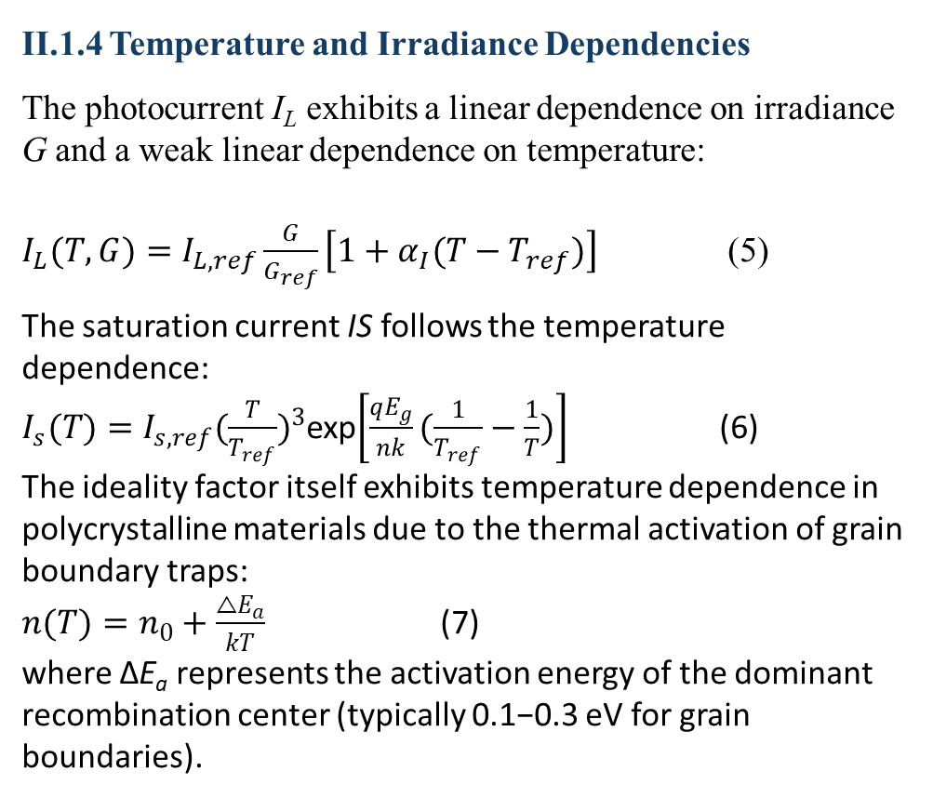
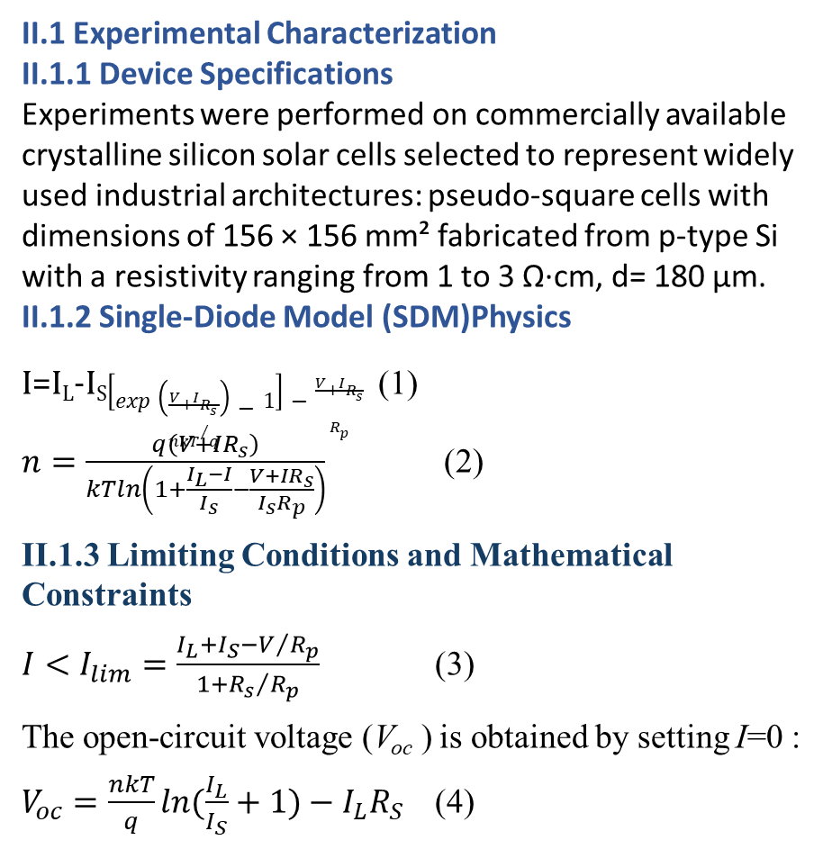
Research method
Plenary
II.1 Experimental Characterization
II.1.1 Device Specifications
Experiments were performed on commercially available crystalline silicon solar cells selected to represent widely used industrial architectures: pseudo-square cells with dimensions of 156 × 156 mm² fabricated from p-type Si with a resistivity ranging from 1 to 3 Ω·cm, d= 180 μm. II.1.2 Single-Diode Model (SDM)Physics
I=I_{L}-I_{S}$\left[exp\left(\frac{V+IR_{s}}{{nkT}/q}\right)−1\right]−\frac{V+IR_{s}}{R_{p}}$ (1)
$n=\frac{q\left(V+IR_{s}\right)}{kTln\left(1+\frac{I_{L}−I}{I_{s}}−\frac{V+IR_{s}}{I_{s}R_{p}}\right)}$ (2)
II.1.3 Limiting Conditions and Mathematical Constraints
$I<I_{lim}=\frac{I_{L}+I_{S}−V/{R_{p}}}{1+{R_{s}}/{R_{p}}}$ (3)
The open-circuit voltage (V_{oc​} ) is obtained by setting I=0 :
$V_{oc}=\frac{nkT}{q}ln(\frac{I_{L}}{I_{S}}+1)−I_{L}R_{S}$ (4)
II.1.4 Temperature and Irradiance Dependencies
The photocurrent I_{L}​ exhibits a linear dependence on irradiance G and a weak linear dependence on temperature:
$I_{L}(T,G)=I_{L,ref}\frac{G}{G_{ref}}\left[1+α_{I}(T−T_{ref})\right]$ (5)
The saturation current IS​ follows the temperature dependence:
$I_{s}(T)=I_{s,ref}{(\frac{T}{T_{ref}})}^{3}$exp$\left[\frac{qE_{g}}{nk}(\frac{1}{T_{ref}}−\frac{1}{T})\right]$ (6)
The ideality factor itself exhibits temperature dependence in polycrystalline materials due to the thermal activation of grain boundary traps:
$n(T)=n_{0}+\frac{△E_{a}}{kT}$ (7)
where ΔE_{a}​ represents the activation energy of the dominant recombination center (typically 0.1−0.3 eV for grain boundaries).

Slide 5
Results and discussion
Plenary
III.1 Modeling and Analysis of the Main Characteristics of Solar Cells Using MATLAB
a)
b)
v)
Fig. 1. Dependence of the current on the diode ideality factor for different values of the applied voltage (a),series resistance (b), parallel (shunt) resistance (v), photocurrent (g), and saturation current (d) of the solar cell.
g)
d)

Slide 6
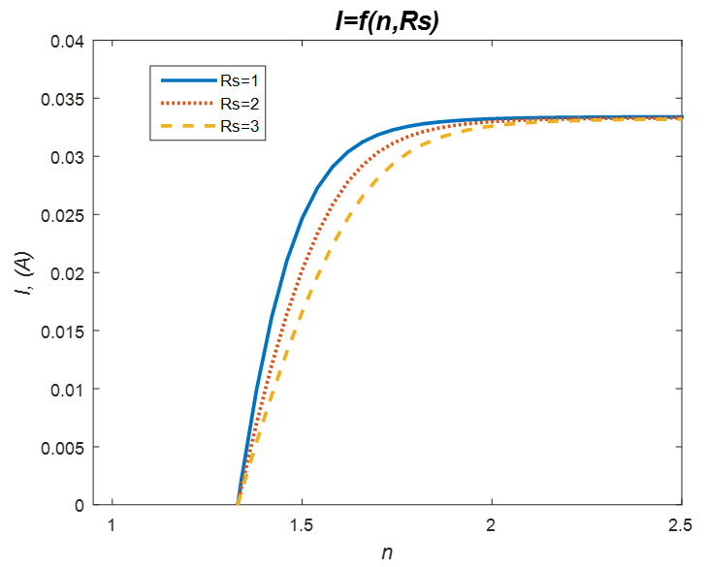
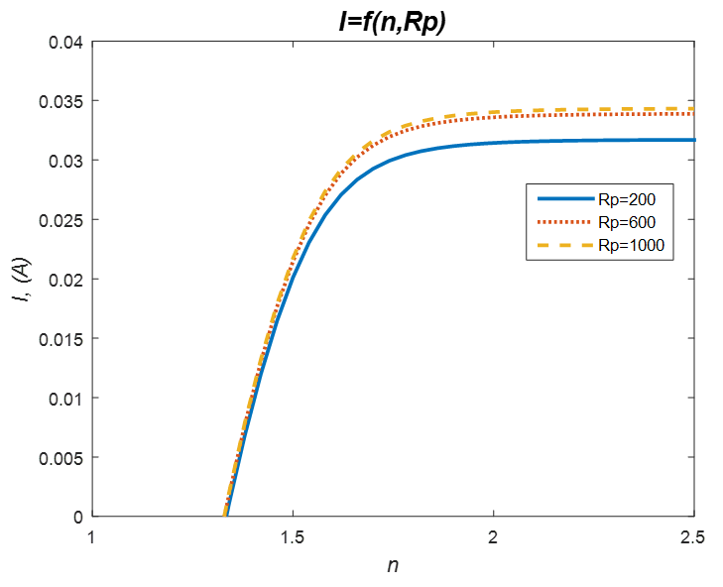
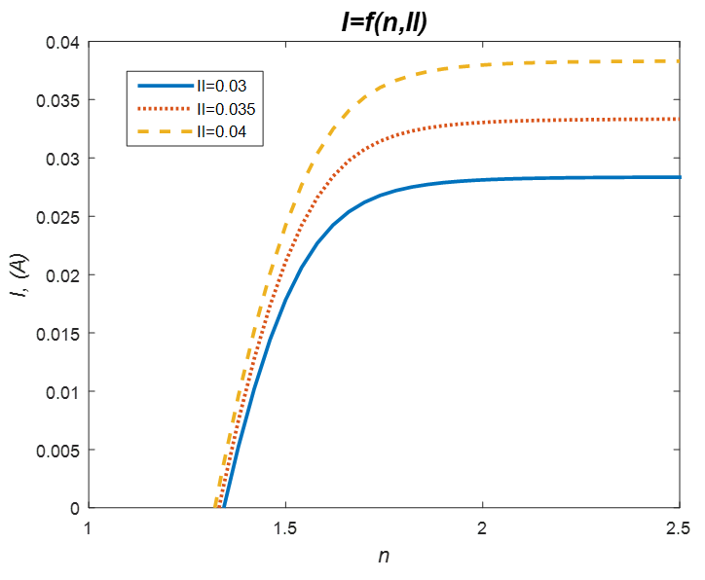
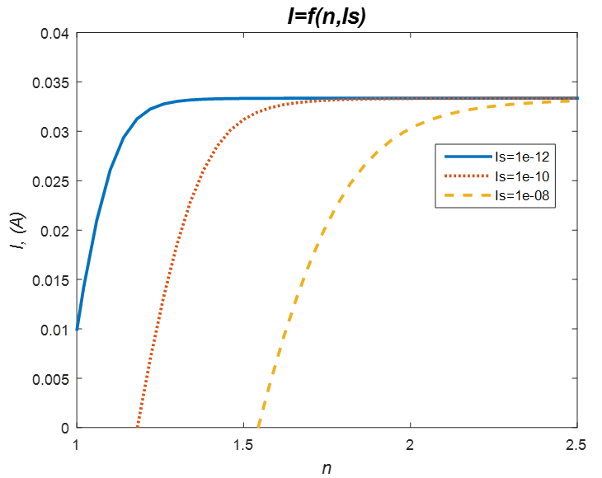
Results and discussion
Keynote Number
01
Plenary
a)
b)
v)
g)
Fig. 2. Dependence of the current on the diode ideality factor for different values of series resistance (a), parallel (shunt) resistance (b), photocurrent (v), and saturation current (g).

Slide 7
Results and discussion
Keynote Number
01
Plenary
a)
b)
v)
Fig. 3. I–V characteristics of the solar cell for different values of the diode ideality factor (a), series resistance (b), parallel (shunt) resistance (v), photocurrent (g), and saturation current (d).
g)
d)

Slide 8
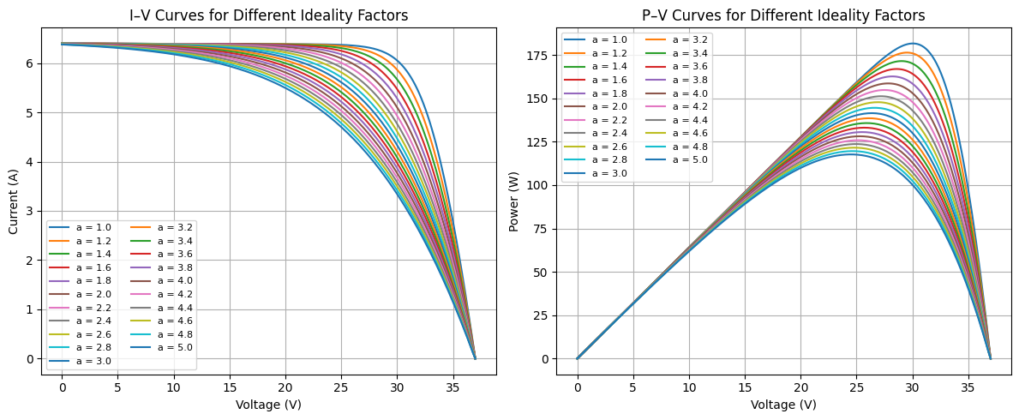
Results and discussion
Keynote Number
01
Plenary
III.2 Modeling and Analysis of Solar Cell Characteristics Using Python
Fig. 4. I–V and P–V characteristics of the solar cell for different values of the non-ideality factor.

Slide 9
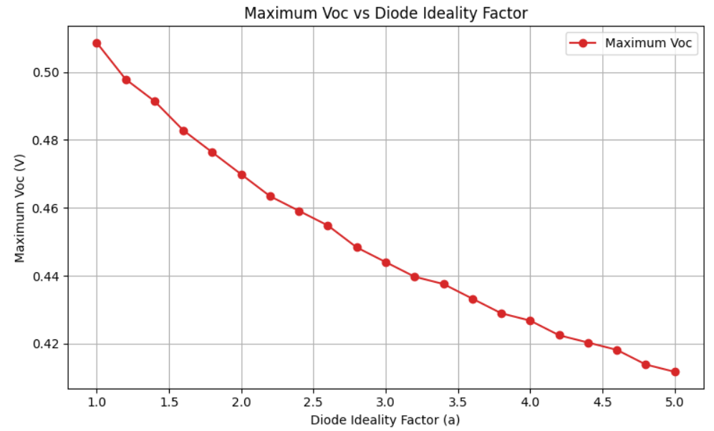
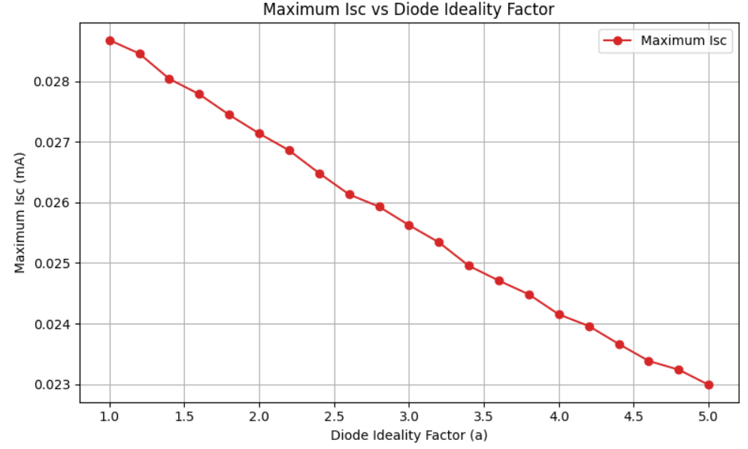
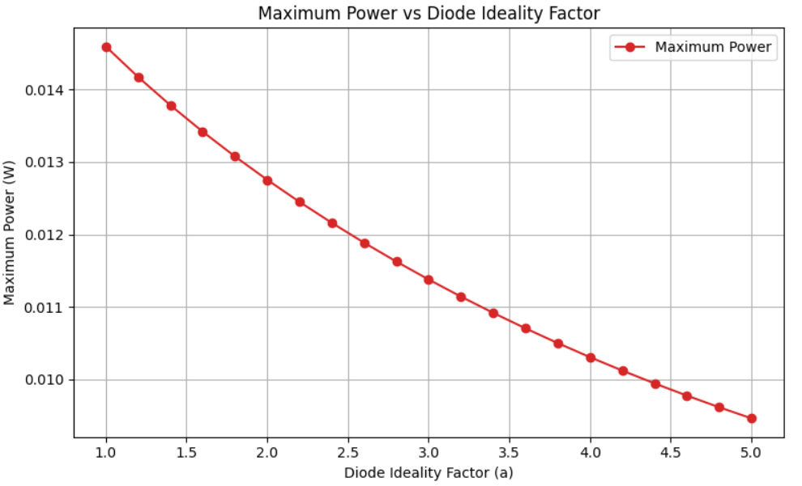
Results and discussion
Plenary
Fig. 5. Dependence of the maximum power and the Isc​ and Voc characteristics at the maximum power point of a monocrystalline silicon solar cell on the diode non-ideality factor.

Slide 10
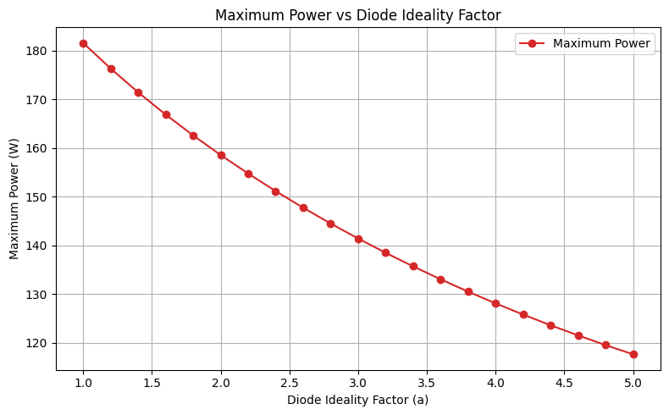
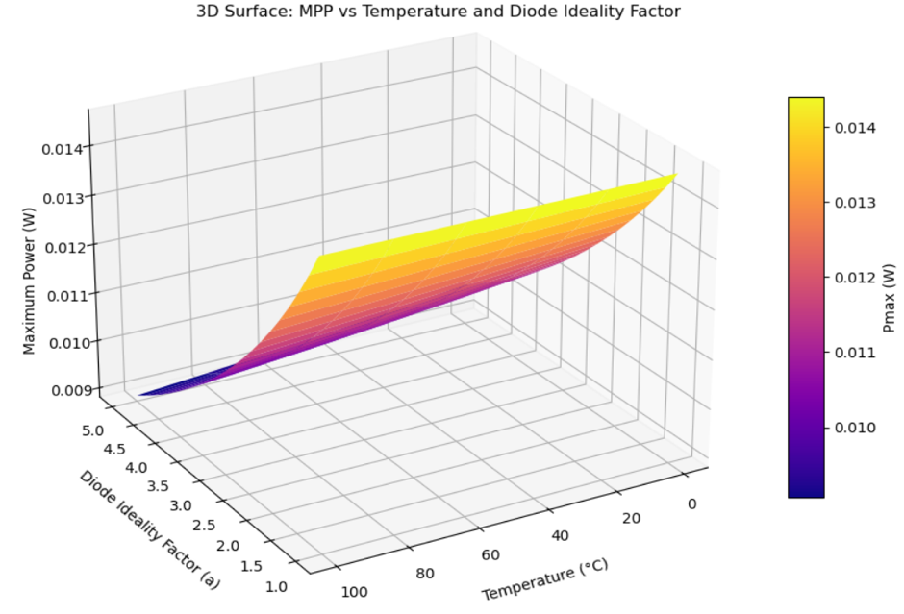
Results and discussion
Plenary
Fig. 6. Graph of the solar cell’s generated photovoltaic power versus irradiance.
Fig. 7. Graph showing the dependence of the solar cell’s generated photovoltaic power on temperature and the non-ideality factor.

Slide 11
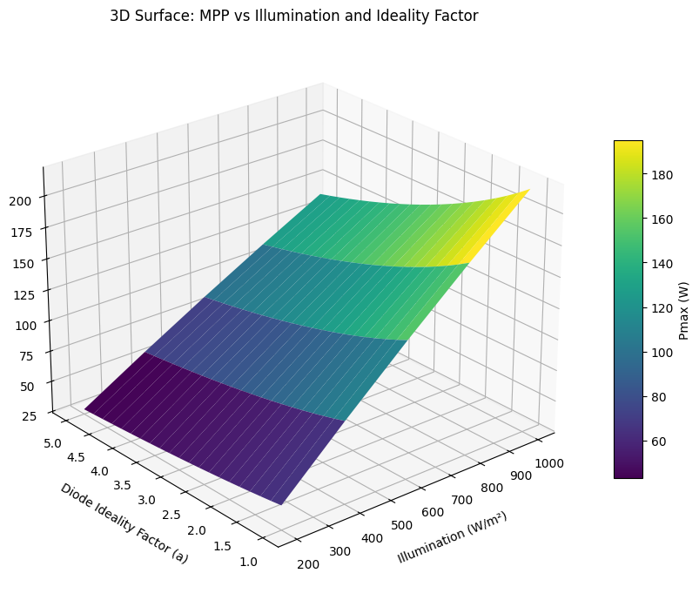
Results and discussion
Plenary
Fig. 8. Graph showing the dependence of the solar cell’s generated photovoltaic power on irradiance and the non-ideality factor.

Slide 12
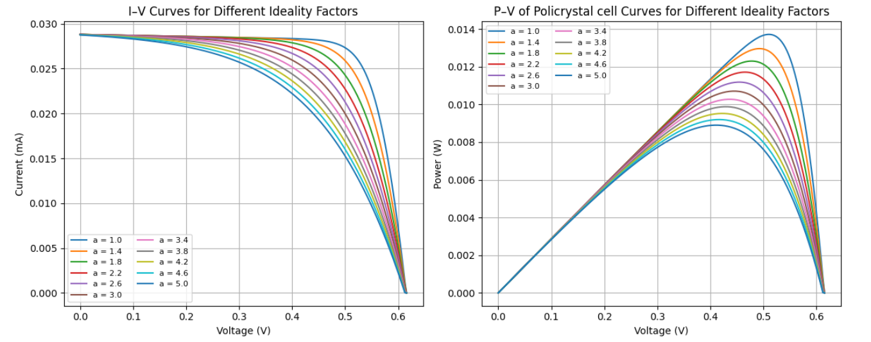
Results and discussion
Plenary
III.3 Comparative Analysis with Polycrystalline Silicon
Fig. 9. I–V and P–V characteristics of a polycrystalline silicon solar cell for different values of the non-ideality factor.

Slide 13
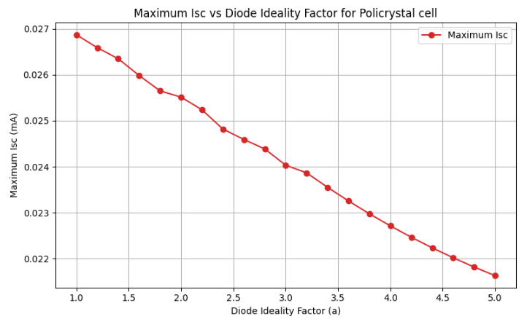
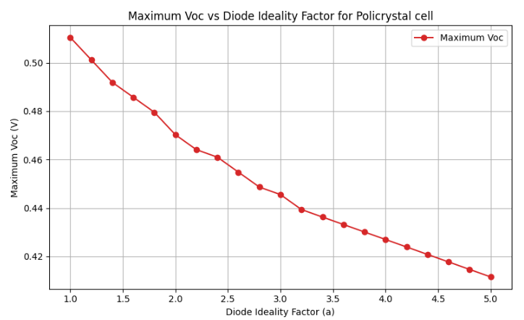
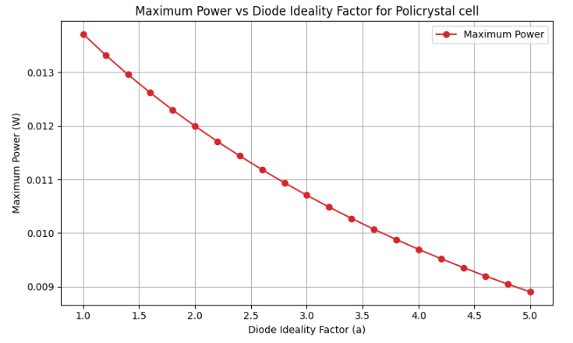
Results and discussion
Plenary
Fig. 10. Dependence of the maximum power (P_{max}) and the I_{sc}​ (a) and V_{oc​} (b) parameters at the maximum power point of a polycrystalline silicon solar cell on the diode non-ideality factor.

Slide 14
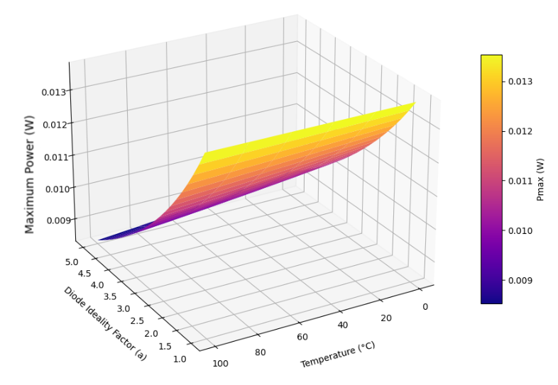
Results and discussion
Plenary
Fig. 11. Graph showing the dependence of the photovoltaic power generated by the polycrystalline silicon solar cell on temperature and the non-ideality factor.

Slide 15
Conclusion
Plenary
This study presents a comprehensive computational investigation into the influence of the diode ideality factor on the photovoltaic performance of crystalline silicon solar cells, employing coupled MATLAB and Python numerical frameworks to analyze experimental data obtained through Suns-Voc characterization. The analysis reveals that the ideality factor serves not merely as an empirical fitting parameter but as a physically meaningful diagnostic variable encoding critical information about dominant recombination mechanisms, material quality, and operational degradation states.
For monocrystalline silicon devices, the voltage-dependent variation of the ideality factor demonstrates a clear transition from diffusion-dominated transport with near-unity values at low forward bias to depletion-region recombination characterized by elevated values approaching 1.3–1.5 at higher voltages, providing quantitative insight into the underlying device physics that govern charge carrier dynamics.
The parametric sensitivity analysis establishes distinct functional dependencies among the equivalent circuit parameters, showing that series resistance primarily degrades the fill factor through resistive losses at elevated current densities while shunt resistance becomes critically detrimental only below 400 ohms, and notably confirming that photocurrent remains independent of ideality factor variations, thereby isolating voltage-dependent recombination as the primary mechanism of performance degradation.
A particularly significant finding emerges from the investigation of coupled temperature and irradiance effects, where synergistic behaviour produces power losses exceeding the arithmetic sum of individual thermal and recombination contributions under high-irradiance conditions, a non-linear degradation mechanism that explains the systematic underperformance of field installations relative to laboratory projections based exclusively on temperature coefficients.

Slide 16
Conclusion
5. The comparative analysis between mono- and polycrystalline silicon materials yields a counter-intuitive yet robustly supported conclusion regarding thermal stability, wherein polycrystalline devices exhibit substantially reduced temperature sensitivity of the ideality factor despite their higher baseline values, an observation attributed to grain-boundary trap saturation effects that partially compensate for intrinsic thermal activation of recombination centers.
6. This thermal stability advantage suggests superior energy yield potential for polycrystalline silicon in climates characterized by large diurnal temperature variations or limited cooling infrastructure, challenging the prevailing paradigm of unconditional monocrystalline preference and establishing a climate-specific optimization framework for material selection.
7. The methodological contribution of this work resides in the demonstrated efficacy of the dual-platform computational approach, combining MATLAB's Newton-Raphson iteration for precision parameter extraction with Python's extensive visualization capabilities for comprehensive parametric mapping, achieving convergence accuracy superior to metaheuristic alternatives while reducing computation time by over ninety percent. The quantitative relationship between ideality factor elevation and power degradation, with losses exceeding twenty percent at values above 2.5, enables the development of predictive maintenance protocols wherein real-time monitoring of this parameter serves as an early diagnostic indicator for potential-induced degradation, corrosion-induced shunting, and encapsulant failure, thereby supporting proactive intervention strategies that mitigate revenue loss in utility-scale installations.
8. These findings inform immediate engineering specifications including critical thresholds for shunt resistance and series resistance that define manufacturing process windows, as well as system-level design recommendations for bypass diode implementation in modules with non-uniform junction quality distributions.

Slide 17

Plenary
PhD
PhD
PhD
PhD
PhD
PhD
Thank you for attention!
Andijan state university, Uzbekistan. 170100 – Andijan, University Street, No. 129
www.adu.uz www.reslab.uz
Tel. +998 90 2167260. E-mail: alievuz@yahoo.com

