Slide 1

Warsaw University of Technology
Faculty of Power and Aeronautical Engineering
The Growth of RES Capacity in the Polish Energy Sector
Artur Rusowicz
20 May 2026

Slide 2
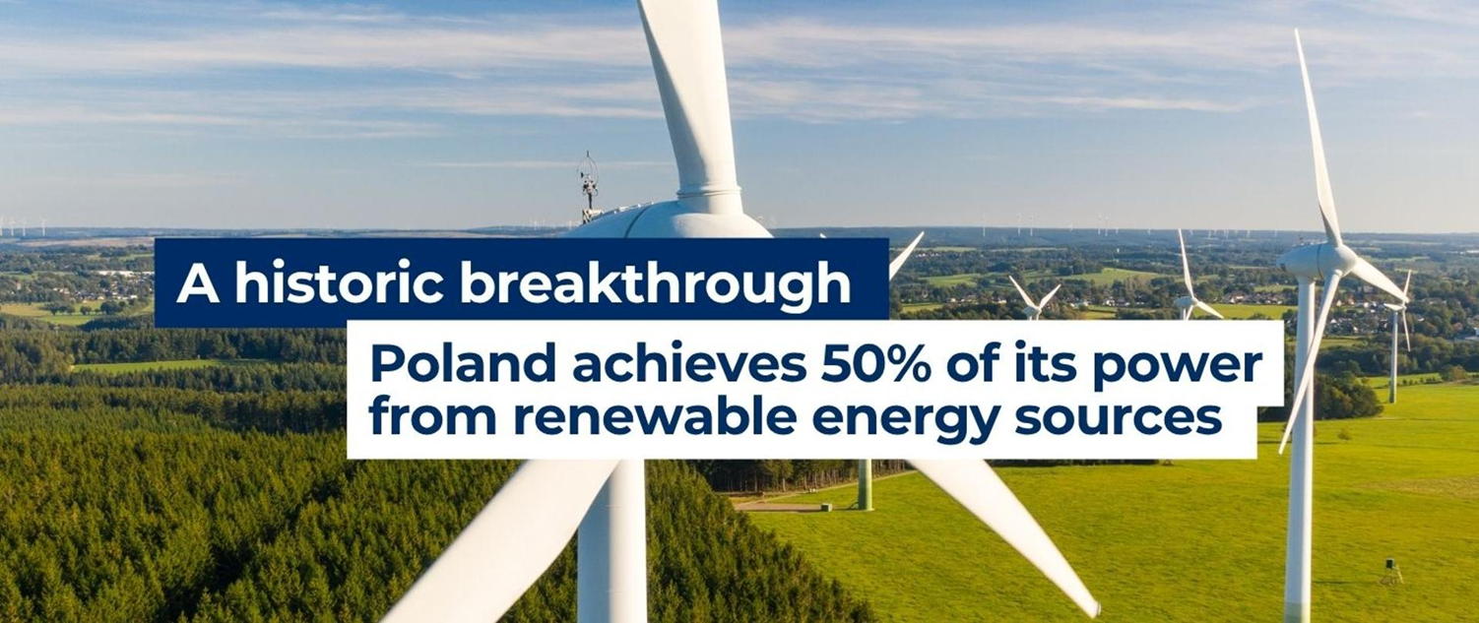
Renewable energy and energy efficiency in the ХХІ century
In recent years, the development of renewable energy sources in Poland has clearly accelerated. The changes that took place between 2020 and 2025 show how quickly the importance of green energy in the power system is growing. According to data from the Energy Market Agency, in 2020, RES installations accounted for 24.12% of installed capacity, with a total capacity of 12,490 MW. By 2025, RES capacity had increased to 37,777 MW, more than tripling in a very short time

Slide 3
Renewable energy and energy efficiency in the ХХІ
Highlights
At the end of 2025, the share of renewable energy sources in Poland's installed capacity was 50.04%.
The total capacity of renewable energy installations at the end of December was 37,777 MW.
Energy production from RES is also growing – in 2025, almost 55,000 GWh of energy came from renewable sources, which is 31.41% of the electricity produced in Poland.
Over the course of five years, the share of energy from RES in total production increased from 17.83% in 2020 to 31.41% in 2025, which means that almost every third kilowatt-hour produced in Poland came from RES.

Slide 4
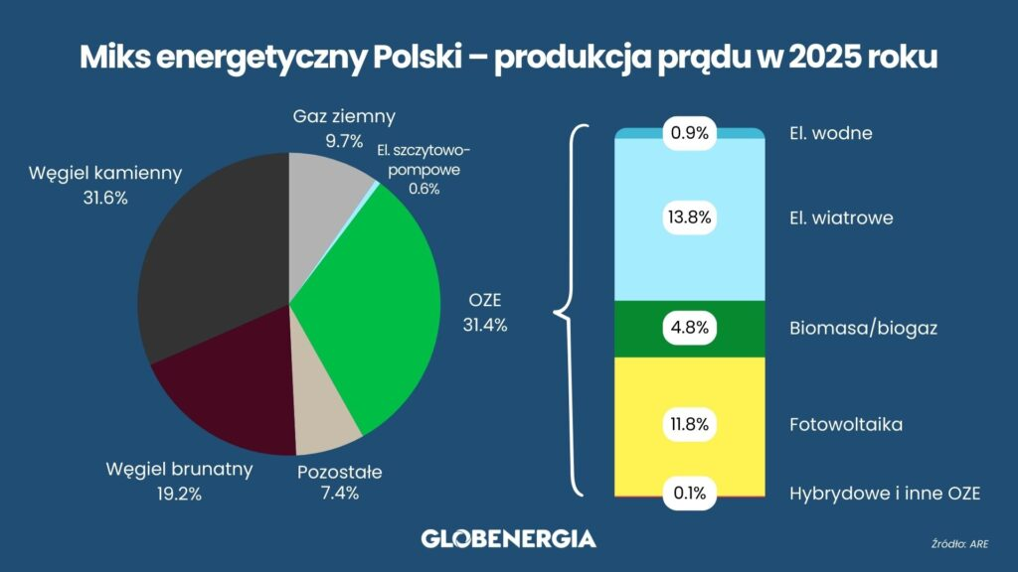
Renewable energy and energy efficiency in the ХХІ
For the first time in history, the share of hard coal and lignite in electricity production fell below 50% during a six-month period in 2025. At the end of the year, it stood at 52.6%. Renewable sources accounted for 31.5 percent of energy production, natural gas for 14.1 percent, and other fossil fuels – 1.8 percent

Slide 5
Renewable energy and energy efficiency in the ХХІ
Highlights
At the end of 2025, the share of renewable energy sources in Poland's installed capacity was 50.04%.
The total capacity of renewable energy installations at the end of December was 37,777 MW.
Energy production from RES is also growing – in 2025, almost 55,000 GWh of energy came from renewable sources, which is 31.41% of the electricity produced in Poland.
Over the course of five years, the share of energy from RES in total production increased from 17.83% in 2020 to 31.41% in 2025, which means that almost every third kilowatt-hour produced in Poland came from RES.

Slide 6
Renewable energy and energy efficiency in the ХХІ
Conclusions
The year 2025 represents not only a record result but, above all, clear evidence of a real and measurable transformation of the Polish energy sector. The growth in generation from renewable sources is displacing inflexible coal-fired capacity from the market, which leads to increasingly frequent instances of curtailing RES generation – due to the lack of energy storage and flexible demand. The risk of system imbalance is growing, particularly during periods of record peak demand for power. This shows that further transformation requires not only the expansion of renewable capacity, but above all the modernization of infrastructure, the development of storage, and support for flexibility on the consumer side.

